Slide 1
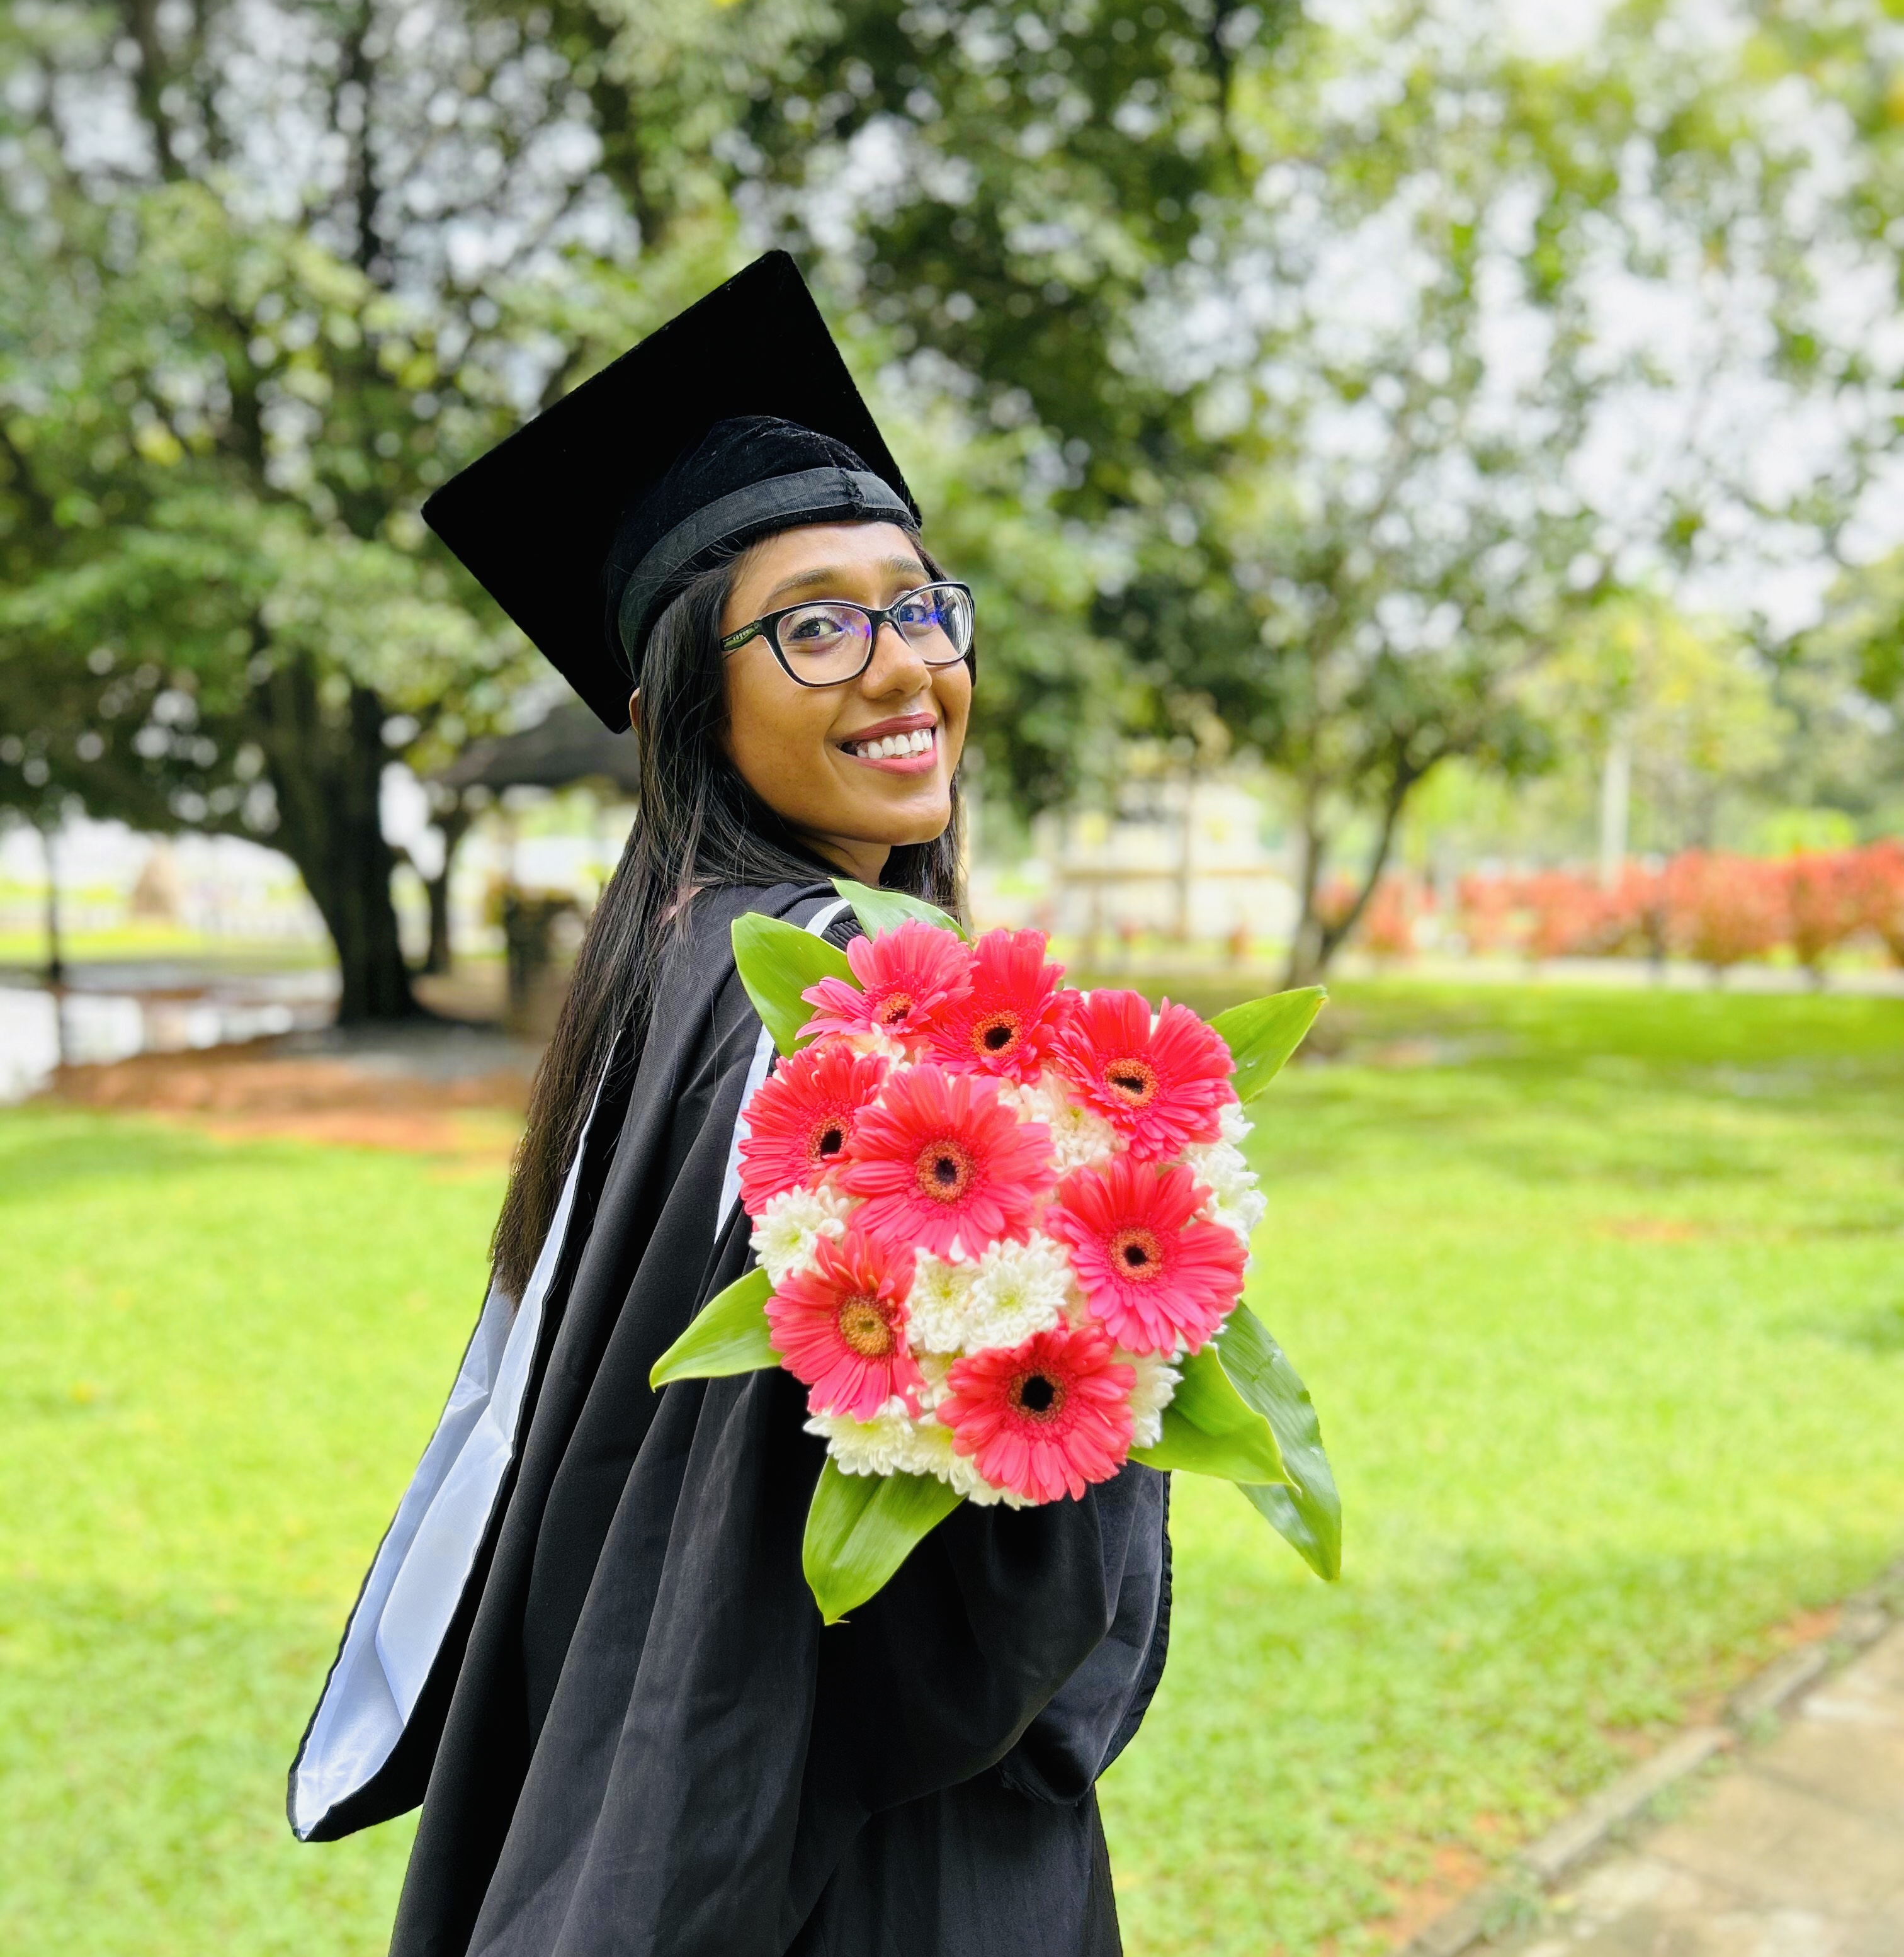
Tharuka Kasthuriarachchige
PHD Student, BTH
Theme D
Current Research Area : Federated Learning
Notes:
Line spacing + Page numbers

Slide 2






Personal Profile
Blogger.
Active open-source contributor.
Looking forward to enhancing my knowledge.
Work Experience
4 years experience in the industry..
Working experience in machine learning, deep learning, and natural language processing.
Skills
Python programming language
Machine learning
Deep learning
Distributed AI
Natural Language processing
Big Data Programming
Education
Msc in Big Data Anyalitics
(Robert Gordon University, Scotland)
Bsc (Hons) in Computer Science
University of Jaffna
Hobbies
Reading
Blogging tech stuffs
Swimming and traveling

